Slide 1
Node Js Streams & Async Genrators
Notes:
היום בפלטפורמה אנחנו עובדים בתצורה של Rest
מכינים גוש של את ה data
ומעבירים אותו בחזרה

Slide 2


Slide 3


Slide 4
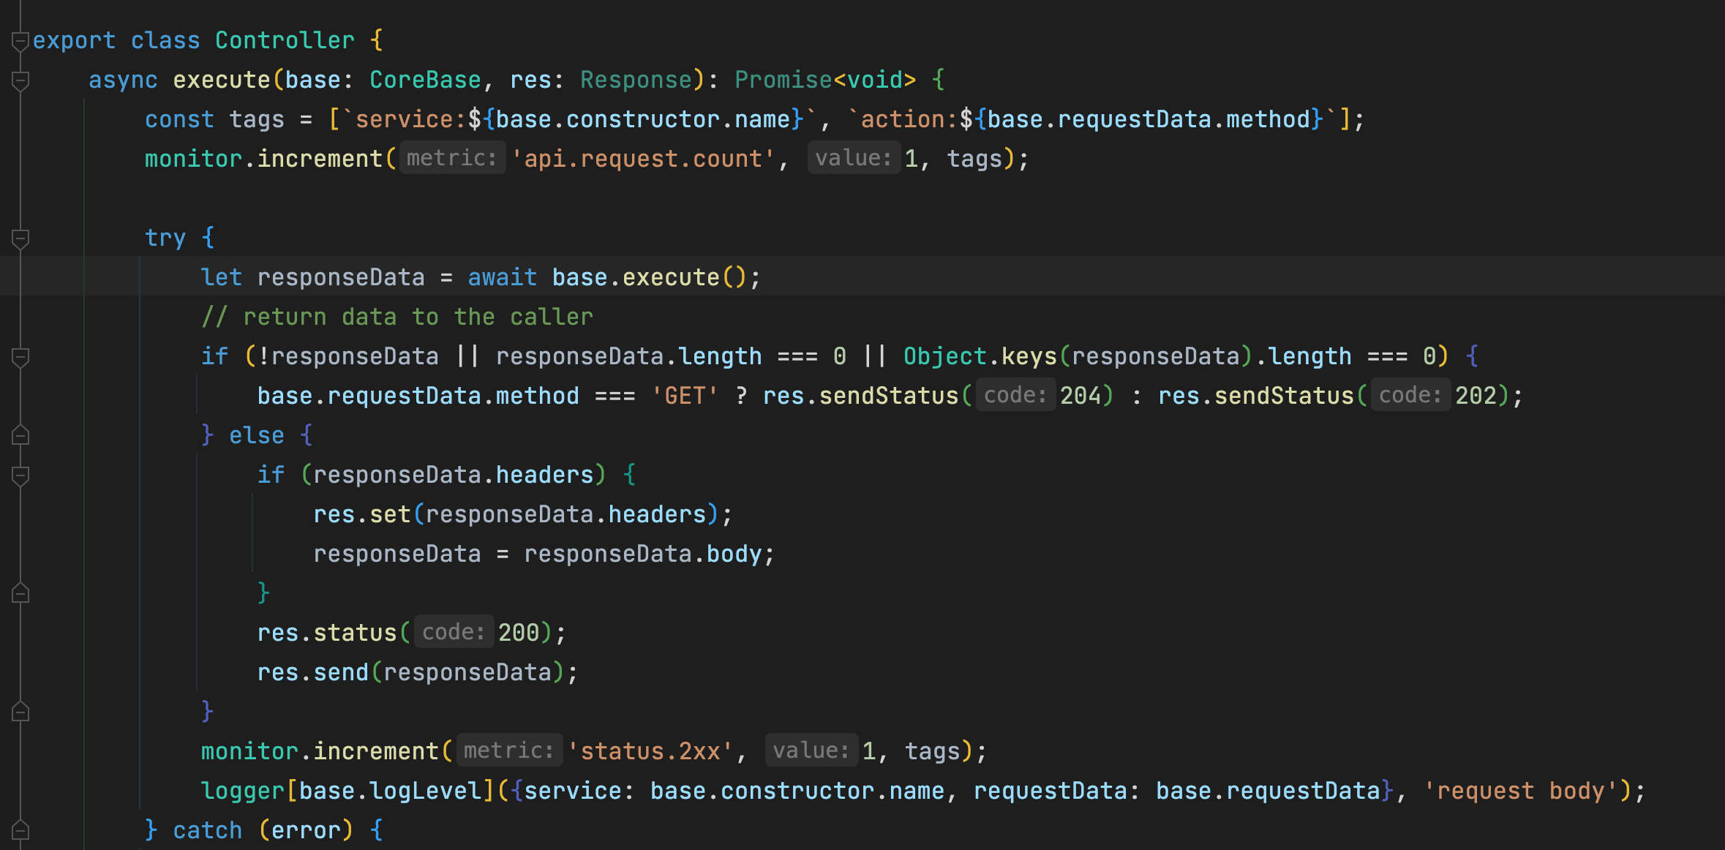

Notes:
Express code response json , send
https://github.com/expressjs/express/blob/ee228f7aea6448cf85cc052697f8d831dce785d5/lib/response.js#L174
https://github.com/expressjs/express/blob/ee228f7aea6448cf85cc052697f8d831dce785d5/lib/response.js#L122

Slide 5


Slide 6

The problem
Data increased over time and reach a point when can’t be handle in simple rest anymore.

Slide 7
Reasons:
Server limited in Memory size today each node server as 5G of heap memory
V8 can’t store string larger than 64 bit which is ~2GB in RAM

Slide 8


Slide 9


What is a stream?
A stream is bassicly a pipe of data between 2 or more sources
To make it easy to think Its bassicly an abstraction of batching mechanisem when we don’t need to manage the batch size or triggerring call to next batch and all network overhead are spared .

Slide 10
Streams types
Readable stream A readable stream represents a source from which data is consumed. In a way, you can see Readable streams as an abstraction to consume some input.
Duplex and Transform streams A Duplex stream is essentially a stream that is both Readable and Writable. It is an ideal abstraction to represent readable and writable pipes like TCP connections.
Writable stream is an abstraction that allows you to write data over a destination. In a way you can see Writable streams as an abstraction for output.

Slide 11
Pipe
Bassicly the glue between streams
The same as in terminal command
streamA.pipe(StreamB).pipe(…
The output of streamA became the input of streamB

Slide 12

Problem with node stream
A lot of Cognitive load
Documentation Not keeping the same format of examples
Documentation Not using intuitive examples
API In my opinion not written well
Notes:
אני חייב רגע לעצור ולהגיד שלדעתי ה תצורה שבה כתוב היום ה אפי של
stream
הוא לא משהו ודיי נוגד את כל הסמנטיקה של node
ואני מניח גם שזאת הסיבה שרוב המפתחים מסתבכים עם הנושא הזה וגם השאלות ב stack over flow תמיד חוזרות על עצמם
אני ינסה לפשט את זה כמה שאני יכול אחר כך מי שרוצה לצלול קצת יותר בכיף

Slide 13
Readable Streams
- Read a file from the filesystem: `fs.createReadStream(file)`
- Command line standard input: `process.stdin`
- An HTTP response (received by a client)
- An HTTP request (received by a server

Slide 14
Readable Streams
Readable stream as 2 types
Flowing mode - When using flowing mode, the data is read from source automatically and chunks are emitted as soon as they are available.
Paused mode – When using paused mode on a Readable stream, a consumer does not receive chunks, but instead, it has to call the `read` method explicitly to read chunks of data from the stream. The stream emits a `readable` event to signal that new data is available and that `read()` should be called to read the data.
Notes:
Examples:
Basic-examples/readable-basic-flowing.js
Basic-examples/readable-basic-paused.js

Slide 15
Readable Streams - Custom
Im most cases we are not going to read from file and we need to create our input source
For example, data from apis or data base
to create a custom Readable stream we must extend the `Readable` class and implement the `_read()` method
Notes:
Examples:
Basic-examples/costum-readable/cls.js
Basic-examples/costum-readable/push-directly.js
Expose push function inside _read bad api
Different typt of implemantation can confuse
From now on all examples I show will be with class inharatance

Slide 16
Duplex and Transform streams
Duplex streams are a special class of Duplex streams in which the data that is written in one end of the stream is internally modified so that it can be read in its new form on the other end. This essentially a way to be able to do in flight transformations and it's very useful in multiple cases:
- Compression / Decompression
- Encryption / Decryption
- Data filtering and aggregation
- Data enrichment
- Media transcoding

Slide 17
Duplex and Transform streams
Creating custom Transform streams is unsurprisingly similar to creating custom Readable streams. Also in this case it's just a matter of extending the `Transform` class. This time though, we have to implement the `_tranform` method which accepts 3 arguments:
`chunk`: the current chunk of data to transform
`enc`: a string that represents the current encoding of the data
`cb`: a callback to invoke when the transformation is done. This allows you to have asynchronous transformations.
Notes:
Example code upercasify

Slide 18

Duplex and Transform streams
Manipulate data after function ? ☺
Notes:
Example code upercasify

Slide 19
Writable Streams
A Writable stream is an abstraction that allows you to write data over a destination. In a way you can see Writable streams as an abstraction for output.
Some examples of Writable streams:
- Writing to a file with `fs.createWriteStream()`
- Command line standard output and standard error (`process.stdout`, `process.stderr`)
- An HTTP request (when sent by a client)
- An HTTP response (when sent by a server)

Slide 20
Writable Streams
Same api as for implemention as the duplex stream which accepts 3 arguments and override _write method:
`chunk`: the current chunk of data to transform
`enc`: a string that represents the current encoding of the data
`cb`: a callback to invoke when the transformation is done. This allows you to have asynchronous transformations.

Slide 21
Problems with streams

